Slide 1

Risk in Financial Services
Demonstrate knowledge and understanding of risk in a financial services environment: 119997
Notes:
This summary CAN be used on completion of the group discussion and peer assessments, IF YOU FEEL ANY POINTS ON COMPLIANCE NEED TO BE CLARIFIED.
If you are satisfied with the knowledge, skills and attitude relating to compliance demonstrated then skip the next 5 slides and move to the ETHICS segment.

Slide 2
Outcomes
Explaining the concept of risk in a financial services environment
Explaining the relationship between investment instruments and financial markets
Demonstrating insight into current global economic issues
Developing a group investor profile
Applying the principles of risk to make a financial decision

Slide 3
Concept of Risk
Explaining the concept of risk in a financial services environment.
Notes:
As a financial advisor, you can help clients by doing the following:
• Encourage clients to invest for the long-term, especially when investing in the more risky asset classes.
• Emphasise diversification – a well-diversified portfolio based on a well-thought out investment allocation policy that fits the client’s long-term goals is a prerequisite to the financial well-being of the client.
• Encourage clients to look at the big picture – there are going to be ups and downs in the market. The research has found that investors tend to obsess on individual, short-term losses and gains but especially the losses. Investors then become conservative, thereby undermining their long-term investment goals.
Successful investors place little emphasis on individual gains and losses in their portfolios. The reason for this being that research has shown that over time even though specific investments or investment categories may suffer losses, in a properly diversified portfolio, the overall portfolio performance will be positive over time. This will happen with less risk than if the investor tried to avoid losses by putting everything into the current ‘hot’ investment.
Investors such as these understand that investing is only part (although a key part) of building a positive financial picture for themselves – building total wealth is what really counts.
Source: Financial Planning Association, USA.

Slide 4
Objectives
Encourage clients to invest for the long-term when investing in the more risky asset classes.
Emphasize diversification – a well-diversified portfolio based on a well-thought out investment allocation policy that fits the client’s long-term goals is a prerequisite to the financial well-being of the client.
Encourage clients to look at the big picture – there are going to be ups and downs in the market.

Slide 5
Types of Risk
Currency Risk
Liquidity Risk
Financial Risk
Market Risk
Timing Risk
Income Risk
Notes:
Depending on the nature of the investment, the type of investment risk will vary.
A common concern with any investment is that you may lose the money you invest - your capital. This risk is therefore often referred to as "capital risk."
If the assets you invest in are held in another currency there is a risk that currency movements alone may affect the value. This is referred to as "currency risk."
Many forms of investment may not be readily salable on the open market (e.g. commercial property) or the market has a small capacity and can therefore may take time to sell. Assets that are easily sold are term liquid therefore this type of risk is termed "liquidity risk."
The risk that there may be a disruption in the internal financial affairs of the investment, thereby causing a loss of value, is called "financial risk." A prime example of that form of risk was experienced by the investors in Enron, or one of the "dot-com" stocks that really never did have a profitable financial footing. Many of the employees of Enron experienced both liquidity and financial risk as the price decline in the stock of that company occurred just as there was a "freeze" on stock liquidation in their retirement plans.
Perhaps the most familiar but often least understood form of investment risk is "market risk." In a highly liquid market like the collective stock exchanges in the United States and across the developed world, the price of securities is set by the forces of supply and demand. If there is a high demand for a given issue of stock, or a given bond, the price will rise as each purchaser is willing to pay more for the security than the last one. The reverse of that occurs when the sellers want to rid themselves of an issue more than the buyers want to buy it. Each seller is willing to receive less than the last one and the market price, or valuation, declines.
The same form of risks apply to a house, an issue of stock, a mutual fund, or a bond. Some forms of investment risk can be insured against. For example, the risk that an investment rental property might burn down, or the custodian of your stock and bond investments might go out of business. Most of the forms of risk that we concern ourselves with, financial risk, market risk, and even inflation risk, can at least partially be moderated by forms of diversification.
For example, a person investing $10,000.00 for one year may desire a gain of $1,000.00, or a 10% return, providing a total investment of $11,000 after one year. In reality, investing, as opposed to saving, rarely provides such a neat solution. For example, the average annual compound return of the broad American stock market over the time period from 1926 to 2006 was just over 10% per year. During that eighty year period though, there were more than a few times when massive declines in market value were experienced by investors in that same stock market. From early in the year 2000 through the fall of the year 2002 for example, the broad measures of market valuation, such as the S&P 500 Stock Index fell over 50%. For an investor in 2006 to have seen that average compounded 10% return in the S&P 500 Index, he or she would have had to invest in 1994. The 10% average annual rate or return was there, it just took twelve years of patient waiting to see it.
At least the investor in a S&P 500 Index Fund has some degree of assurance that if he or she waits long enough a positive return is very likely to occur. The investor who elected to invest everything in Enron is left only with the assurance that the investment was a complete loss. Enron, as a stock issue, was a part of the S&P 500, and its loss did have a temporary effect on that index, but the effect was not permanent or, in the long run, of any significance. That is the value of diversification. Further diversification away from the large capitalization stocks that make up the S&P 500 Index has historically tended to further reduce market and financial risk.
A science has evolved around managing market and financial risk under the general title of Modern portfolio theory initiated by Dr. Harry Markowitz in 1952 with his seminal article, "Portfolio Selection."

Slide 6

Probability
Probability is the chance that something is likely to happen or be the case.Probability theory is used extensively in areas such as statistics, mathematics, science and philosophy to draw conclusions about the likelihood of potential events and the underlying mechanics of complex systems

Slide 7
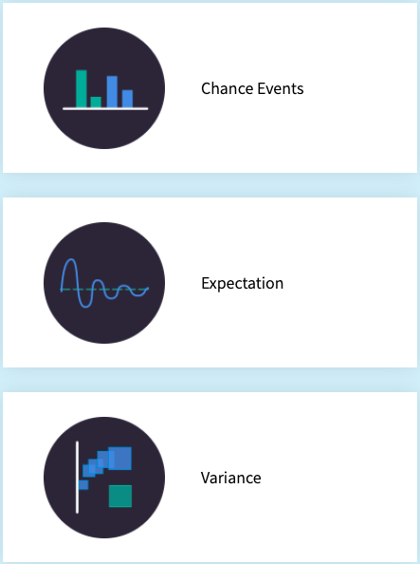
Probability Factors

Slide 8
Influencing Factors for Individuals
Age
Time
Inflation
Rates
Goals
Circumstances
Notes:
The different factors that can affect the client’s risk profile are as follows –
(a) Age
Once again there are different schools of thought with regard to this factor. Does the older client necessarily have a lower risk profile? Lifestyle planning disagrees with this view point and points out that the client who is older and has saved enough for retirement might not necessarily fall into the lower risk category. He can afford to take risks as he has built up a nest egg.
The same theory applies to the younger client who needs to provide for his child’s education, pay off a bond and maintain a lifestyle. Should this client be conservative or should he take risks when investing? The answer to this question cannot be answered by only looking at the age of the client but should take other factors into account such as future needs. If this client needs to build up a substantial shortfall he cannot afford to be totally conservative and should expose himself to a certain amount of risk. Age is an important factor but not the determining factor, which is what most advisors to date have assumed.
(b) Time
The longer the client has to invest, the more risk he should be able to tolerate as markets move in cycles. Should the investor, for example, need to realise money within one years time he will have very little tolerance for risk since there is no opportunity for the investor to wait out the poor market conditions for his capital to recover.
In contrast, an investor who has a long-term strategy will be able to ride the ups and downs (assuming he is properly informed of the investment process and cycles).
The client should not change his investment strategy purely because of under-performance. He should rather stick to the risk profile and maintain exposure to the higher risk investment vehicles.
Research has shown that equities outperform bonds, cash and inflation over a ten-year period.
The table below indicates how the risk within the different asset types is reduced over a longer term by using standard deviation calculations.
Shares Bonds Cash Inflation
1 year 22.94 10.04 6.47 5.6
3 years 13.34 6.21 6.16 5.42
5 years 9.77 5.36 5.95 5.32
10 years 7.38 4.69 5.74 5.04
20 years 5.63 3.43 4.88 4.12
Source: Investment Planning by Brian Goodall
(c) Inflation
The risk of inflation depleting an investment portfolio is a real threat. In a country such as South Africa where the rate of inflation is targeted to be between 3%–6% pa, investments have to outperform drastically. This steady erosion of one’s investment reduces the buying power over a long term. The following example illustrates the effect inflation has on an investment.
In twelve years time an investment of R100 000 will have half its buying power. How was this conclusion reached? The rule of 72 can be used to explain this.
72/6 = 12
It is therefore imperative for the long-term investor to make sure his portfolio is properly structured to accommodate for this phenomenon.
(d) Interest rates
How do interest rates effect an investment? Investments such as government bonds and money market instruments are very closely linked to interest rate movements. In a lower interest rate environment clients may find that low risk fixed interest investments do not give them sufficient income to live on. Another problem is that if interest rates go up the capital value of a bond will decline. If interest rates come down the value could increase. If the investor were to speculate as to whether interest rates would go up or down he could make a fatal error and invest in a long-term investment that is pegged at a lower interest rate or suffer a capital loss if he sells it.
(e) Goals
When discussing the client’s risk profile it is important to take his goals into account. A distinction can be drawn between short-, medium- and long-term goals. Each of these goals are affected by factors such as the client’s personal needs, circumstances and lifecycles. Within the concept of lifestyle planning, goals play an important role.
(f) Circumstances
Events such as the 11 September 2001 terrorist attack on America will have a significant impact on investment returns over a specific period of time. It is important to note that these events cannot be seen in isolation and must not affect the client’s risk profile. In the event of such a disaster, markets usually fluctuate dramatically. The client’s risk profile should not change unless the client’s circumstances change due to such an event.
(g) Client personality
Every client has a different personality and this should be considered when choosing a risk profile. If the client is a very volatile and insecure person it would be foolish to place him in a high-risk investment portfolio.
An important point to remember is than none of these factors can be analysed in isolation. The financial planner and his client must take all the above factors into account and make a rational decision that will satisfy all the client’s needs and expectations.
Different risk profiles consist of different asset types. The different asset types have been discussed in Part 2 of this work.

Slide 9
Relationships
Explaining the relationship between investment instruments and financial markets.

Slide 10
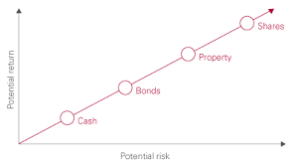
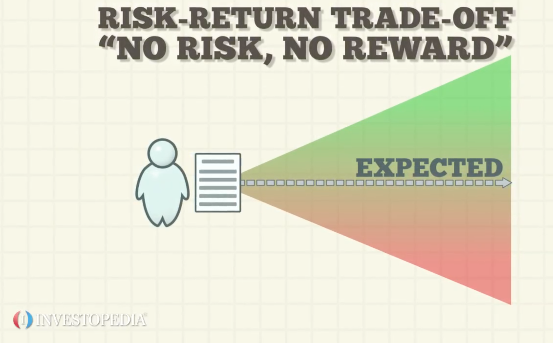
Risk vs Term
Risk
Term

Slide 11
Financial Markets
Capital market instruments
zero coupon bonds;
government bonds;
equity;
property;
Gold
Money market
instruments
cash;
bankers acceptances
treasury bills
promissory notes
negotiable certificates of deposits (NCD)
short-term debentures
bank deposits
Notes:
Below is an illustration of the different risk categories by combining different asset classes.
Note: These are only indicative and may vary from client to client. There are also different levels other than those discussed here.
(a) Conservative
This investor has very little appetite for risk and is looking for long-term capital preservation. There is little possibility of growth in this portfolio and the asset types comprise mostly of cash and bonds. A typical split will be –
• 30% cash;
• 55% bonds;
• 15% equities.
(b) Moderate
The moderate investor is someone who seeks both income and growth. The equity portion slightly outweighs the cash and bond portions. He wants to smooth out the volatility of the portfolio and is seeking long-term growth together with short-term income. The portfolio breakdown is usually as follows –
• 10% cash;
• 35% bonds;
• 55% equities.
(c) Aggressive
The aggressive investor has a high tolerance for risk and seeks high growth opportunities. This portfolio can however be very volatile and should be considered within a long-term strategy. If, however, the investor is doing lifestyle planning, this option might be necessary to meet stated goals and objectives. The portfolio breakdown usually comprises of –
• 5% cash;
• 10% bonds;
• 85% equities.
1.5.2 Return
The second factor a financial planner should consider when drafting an investment plan is the return of the various asset types. There are also different factors that affect the return of an investment. They are as follows –
(a) Asset type
The different asset types are discussed in detail in Part 2 of this work. What follows is a brief overview of the various asset types available and the expected performance thereof. The following asset types have been identified –
• money market instruments;
– cash;
– bankers acceptances (BA);
– treasury bills;
– promissory notes;
– negotiable certificates of deposits (NCD);
– short-term debentures;
– bank deposits;
• capital market instruments;
– zero coupon bonds;
– government bonds;
• equity;
• property;
• tank containers;
• hard assets.

Slide 12
Economic Factors
Trends in Indicators
Inflation
Economic Cycle
Interest Rates
GDP
National Income
Notes:
The economic environment is affected by the way all of the parts of an economic system interact. For obvious reasons, economic factors will have an impact on the financial services sector. When the economy is in a downturn, there may be significantly less spending on financial services and products. On the other hand, when the economy is in an upturn, clients may spend more on financial services and products. Both inflation and interest rates will have an impact on how much money the consumer spends. These factors play a role in influencing national income, economic growth and inflation.

Slide 13
Economic Issues
Demonstrating insight into current global economic issues.

Slide 14
Global Issues
Economic
Political
Environmental
Health

Slide 15
Investor Profile
Developing a group investor profile.

Slide 16
Investor Risk Profile
Notes:
There are a number of risk profiling tools available. They generally consist of a number of different questions relating to risk which are then scored to give a risk profile of a particular client. This risk profile is not carved in stone and may change as circumstances change.
A disadvantage of risk profiling and investing in accordance with the risk profile of the client is that it does not ensure that the client will accumulate sufficient capital to meet their needs and objectives. Clients also have very different ideas about what constitutes risk.

Slide 20
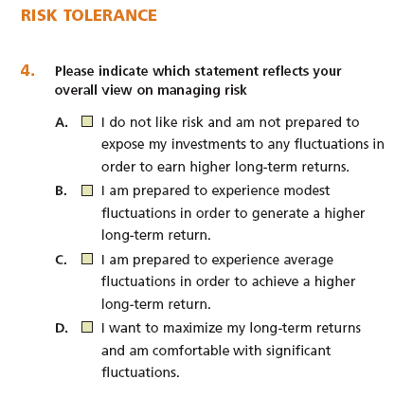

Slide 25
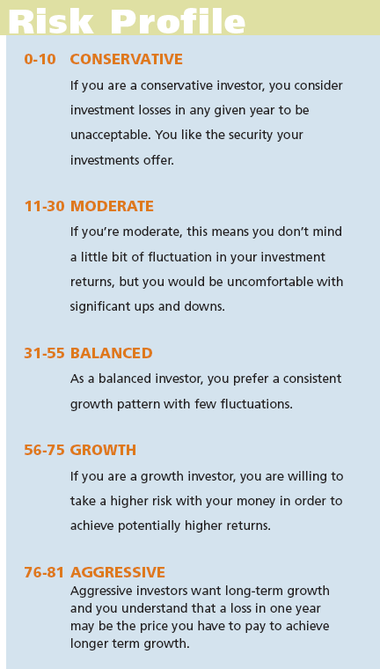
Risk Profile

