Slide 1
Basic Principles of Economics in financial services
Unit Standard 230071

Slide 2
Basic Principles
Discuss the economic cycle
Recession
Depression
Recovery
Boom
Demand and Supply – illustrate graphically
Nominal and Effective rates

Slide 3
Macro vs micro economics
What is the difference?

Slide 4
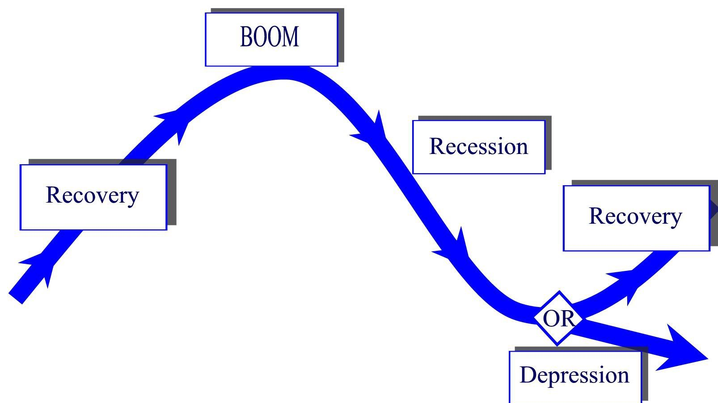
Economic Cycle

Slide 5
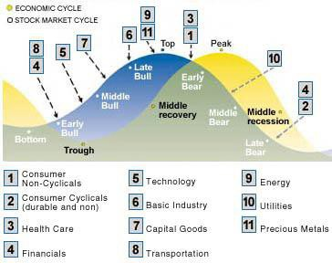
http://personal.fidelity.com

Slide 6
IMPACT OF 2008 CRASH VS PANDEMIC

Slide 7
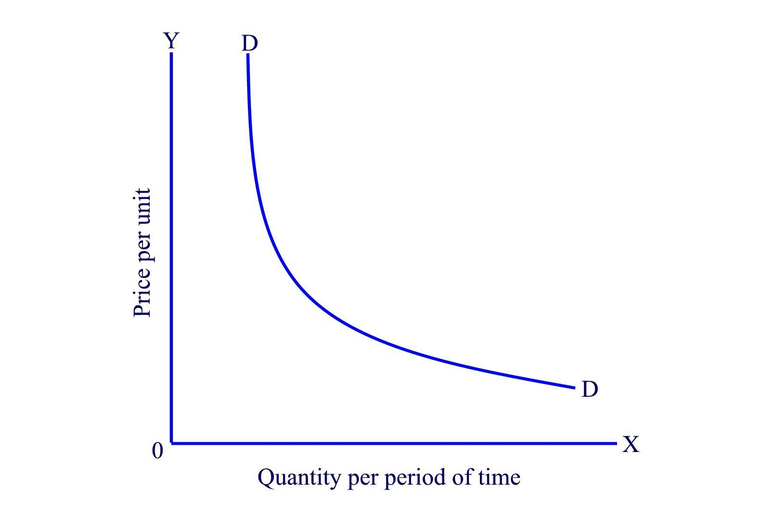
Demand CURVE

Slide 8
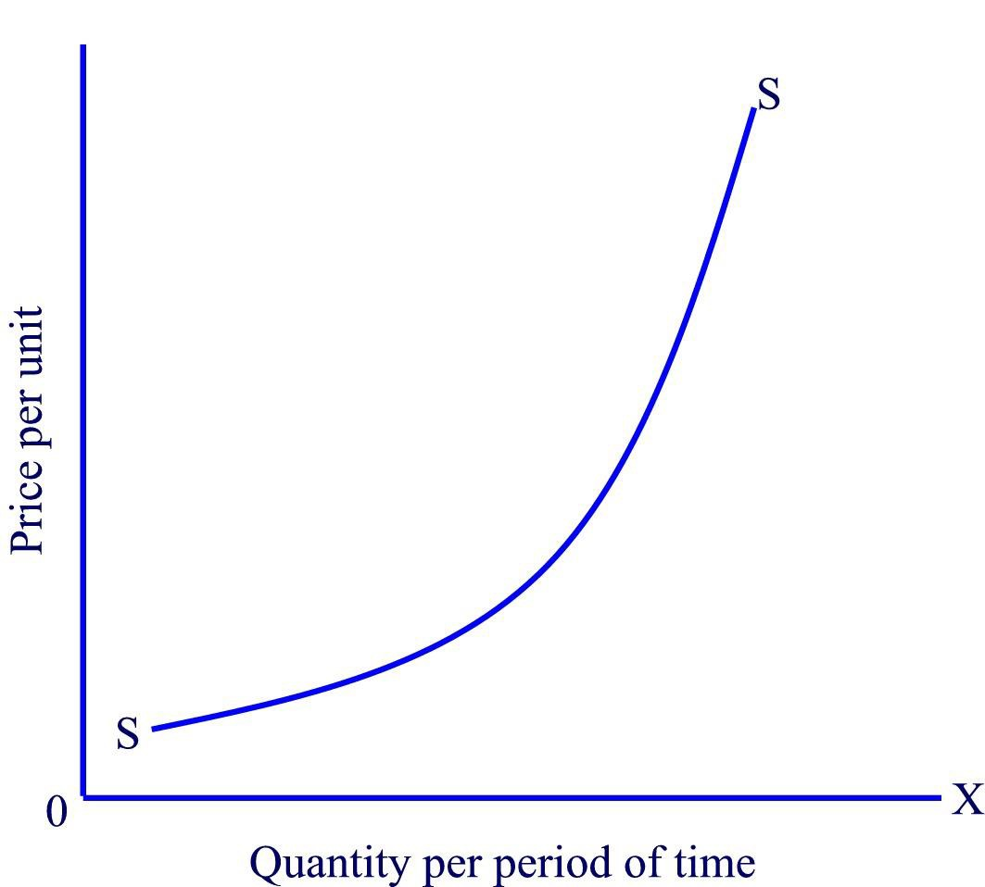
SUPPLY CURVE

Slide 9
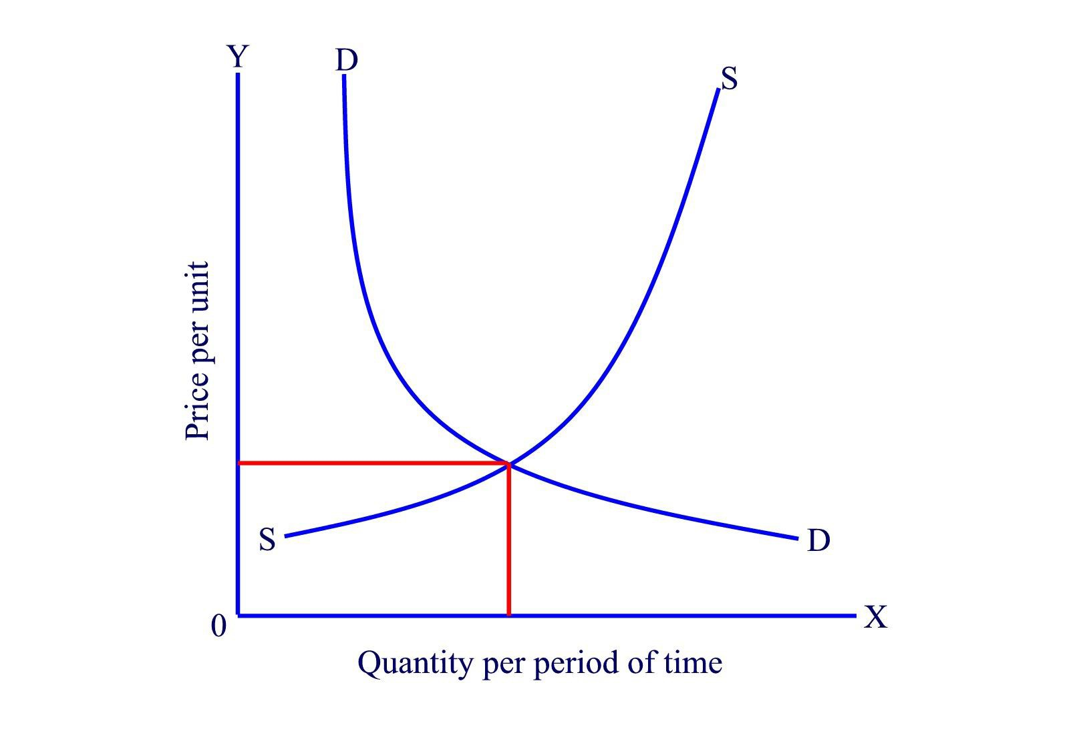
Equilibrium

Slide 10
Economic Indicators
Discuss the following economic indicators:
Inflation as a concept
GDP (gross domestic product)
Interest Rates
Prime Rate
Money market rate
Repro Rate
Borrowing Rates

Slide 11
Flow of production and consumption

Slide 12
Economic Indicators
Relationships between the following indicators:
Inflation
GDP
Interest Rates
Money Supply
Debt
Forex Rates
Current Account
Trade Account
Gold
Oil

Slide 13
Government Policies and Investments
Discuss the following government involvement in the economy:
Monetary Policy
Fiscal Policy
Implications of government involvement in these areas
Current policies and their impact on the economic
environment

Slide 14
Economics and Financial Services
Discuss the following concepts:
Market consensus
Market Response in investment market to release of economic data
Economic forecasts used in investment decisions
Economic indicators that effect investments
How economic forecasts can be used in asset selection.

Slide 15
THE POSITION OF AFRICA IN THE GLOBAL COMMUNITY?

Slide 16
Formative Assessment
As a group use the notes from the group discussions to write up a report in one portfolio which provides detail and input on the following:
Basic Economic Principles
Economic Indicators
Government policies
Economics and financial services

Slide 17
Summative Assessment
A written individual assessment on basic economics and financial services

