Slide 1


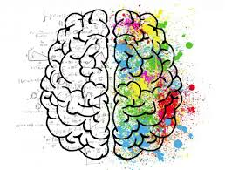
Behavioral finance
Unit Standard: 242557
Notes:
This summary CAN be used on completion of the group discussion and peer assessments, IF YOU FEEL ANY POINTS ON COMPLIANCE NEED TO BE CLARIFIED.
If you are satisfied with the knowledge, skills and attitude relating to compliance demonstrated then skip the next 5 slides and move to the ETHICS segment.

Slide 2

Learning OUTCOMES
Explain the effect of emotion on financial decisions and long term wealth accumulation.
Apply knowledge of behavioural finance to explain investor behaviour.
Discuss how behavioural economics can contribute to understanding market behaviour.
Analyse how financial services organisations respond to behavioural decisions on the part of the market.

Slide 3
Behavioural Finance Explained
Behavioural Finance is the application of individual and collective (group) psychology towards finance and by extension the application to economics. Behavioral finance tries to detect and understand biases/anomalies, and if possible to use them in investment strategies.

Slide 4
Seven Principles of Behavioral Economics
Other people’s behavior matters: People do many things by observing others and copying; people are encouraged to continue to do things when they feel other people approve of their behavior.
Habits are important: People do many things without consciously thinking about them. These habits are hard to change – even though people might want to change their behavior, it is not easy for them.
People are motivated to ‘do the right thing: There are cases where money is de-motivating as it undermines people’s intrinsic motivation, for example, you would quickly stop inviting friends to dinner if they insisted on paying you.
People’s self-expectations influence how they behave: They want their actions to be in line with their values and their commitments.
People are loss-averse and hang on to what they consider ‘theirs’.
People are bad at computation when making decisions: they put undue weight on recent events and too little on far-off ones; they cannot calculate probabilities well and worry too much about unlikely events; and they are strongly influenced by how the problem/information is presented to them.
People need to feel involved and effective to make a change: Just giving people the incentives and information is not necessarily enough
Notes:
a. Other people’s behaviour matters: √ People do many things by observing others and copying; people are encouraged to continue to do things when they feel other people approve of their behaviour. √
b. Habits are important: √ People do many things without consciously thinking about them. These habits are hard to change – even though people might want to change their behaviour, it is not easy for them. √
c. People are motivated to ‘do the right thing’:√ There are cases where money is de-motivating as it undermines people’s intrinsic motivation, for example, you would quickly stop inviting friends to dinner if they insisted on paying you. √
d. People’s self-expectations influence how they behave: √ They want their actions to be in line with their values and their commitments. √
e. People are loss-averse√ and hang on to what they consider ‘theirs’. √
f. People are bad at computation√ when making decisions: they put undue weight on recent events and too little on far-off ones; they cannot calculate probabilities well and worry too much about unlikely events; and they are strongly influenced by how the problem/information is presented to them. √
g. People need to feel involved and effective to make a change: √ Just giving people the incentives and information is not necessarily enough. The theory is contrasted with that of neoclassical economics, further illustrative examples are given and finally the implications of these principles for policy-making are discussed. Our aim is to change the analytical framework for policy as well as to maximise the impact of policy interventions. We also hope to reduce unintended outcomes arising from making decisions based solely on a neoclassical economic analysis. √

Slide 5
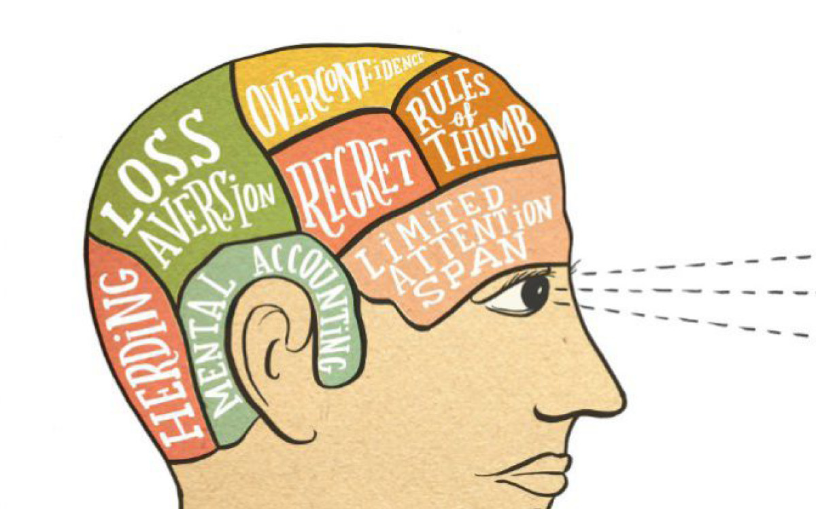
Behavioral Finance Biases

Slide 6
Behavioral Biases
A cognitive bias - can be technically defined as a basic statistical, information processing, or memory error common to all human beings. They also can be thought of as "blind spots" or distortions in the human mind.
  Cognitive biases do not result from emotional or intellectual predisposition toward a certain judgment, but rather from subconscious mental procedures for processing information
On the opposite side of the spectrum from illogical or distorted reasoning we have emotional biases.
  An emotion is a mental state that arises spontaneously, rather than through conscious effort. Emotions are physical expressions, often involuntary, related to feelings, perceptions or beliefs about elements, objects or relations between them, in reality or in the imagination.

Slide 7
Neo-Classical Economics vs Behavioral Economics

Slide 8
Technical Analysis and Fundamental Analysis
Technical Analysis
  Is a method of evaluating securities by analyzing statistics generated by market activity such as past prices and volume. Technical analysts do not attempt to measure a security's intrinsic value, but instead use charts and other tools to identify patterns that can suggest future activity
  Technical analysts believe that the historical performance of stocks and markets are indications of future performance.
Fundamental Analysis
  A method of evaluating a security by attempting to measure its intrinsic value by examining related economic, financial and other qualitative and quantitative factors.
  Fundamental analysts attempt to study everything that can affect the security's value, including macroeconomic factors (like the overall economy and industry conditions) and individually specific factors (like the financial condition and management of companies)

Slide 9
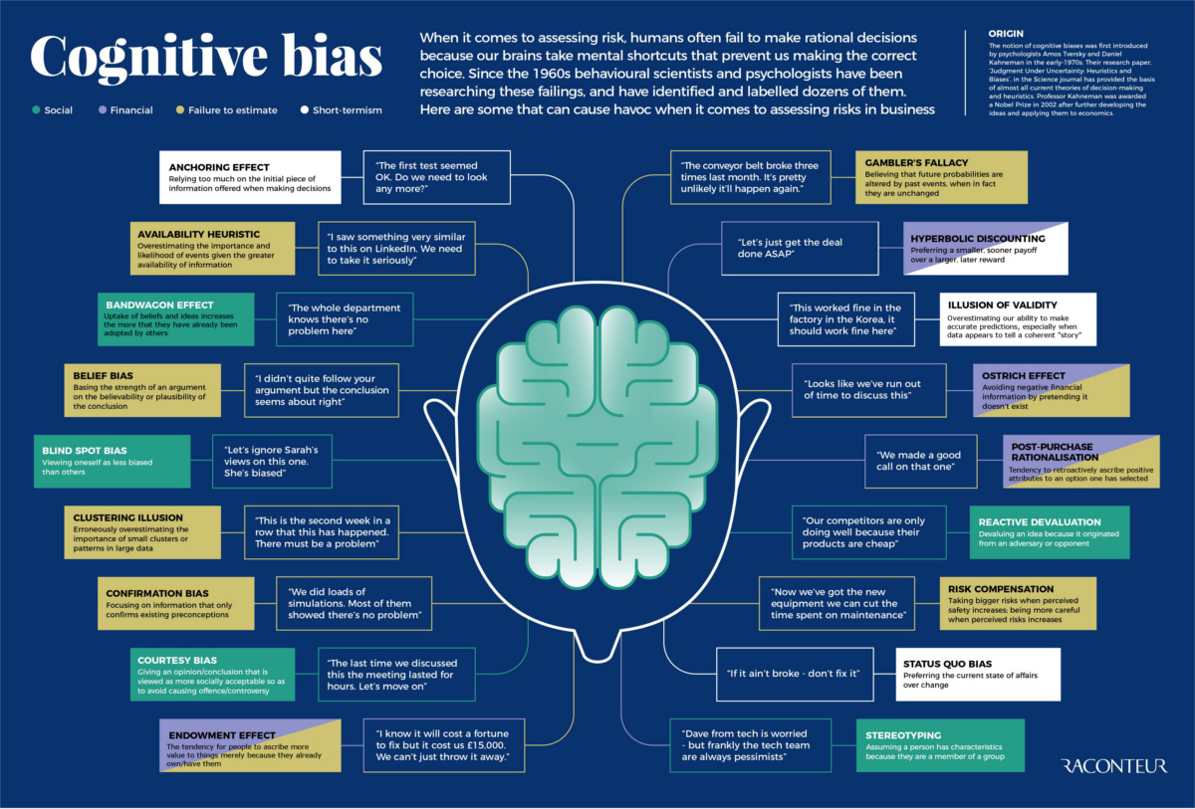

Slide 10
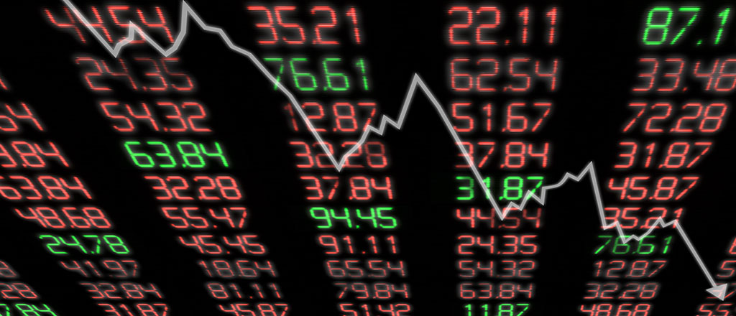
Market behavior with reference to volume, volatility and predictable influence on asset prices.

